Slide 1
The Wampanoag and The Wetu

Slide 2
Welcoming the Wampanoag
The Pilgrim Gallery at Bassetlaw Museum Retford welcomed members of the Wampanoag who built a traditional Wetu at the museum in September 2021.
You will be visiting the museum, to explore the Wetu that the Wampanoag built.
In order to prepare you for your visit, here are some things to watch and do.
We can’t wait to see you and welcome you to the Wetu!

Slide 3
Before you visit you will…
Learn who the Nottinghamshire Pilgrims were and why they left for America.
Discover who the Wampanoag are and a little more about their culture.
Discuss the different perspectives of the Pilgrims and the Wampanoag.
Find out what a Wetu is and why it is important.

Slide 4
Who are the Nottinghamshire Pilgrims?

Slide 5
List as many things as you can remember about the Nottinghamshire Pilgrims from this video! You have 3 minutes!

Slide 6
Who are the Wampanoag?

Slide 7
List as many things as you can remember about the Wampanoag Tribe from this video! You have 3 minutes!

Slide 8
What brought their worlds together?

Slide 9
List as many things as you can remember about how the Nottinghamshire Pilgrims met the Wampanoag Tribe from this video! You have 3 minutes!

Slide 10
The Wampanoag and the Wetu

Slide 11
List as many things as you can remember about the Wampanoag Tribe and a Wetu from this video! You have 3 minutes!

Slide 12
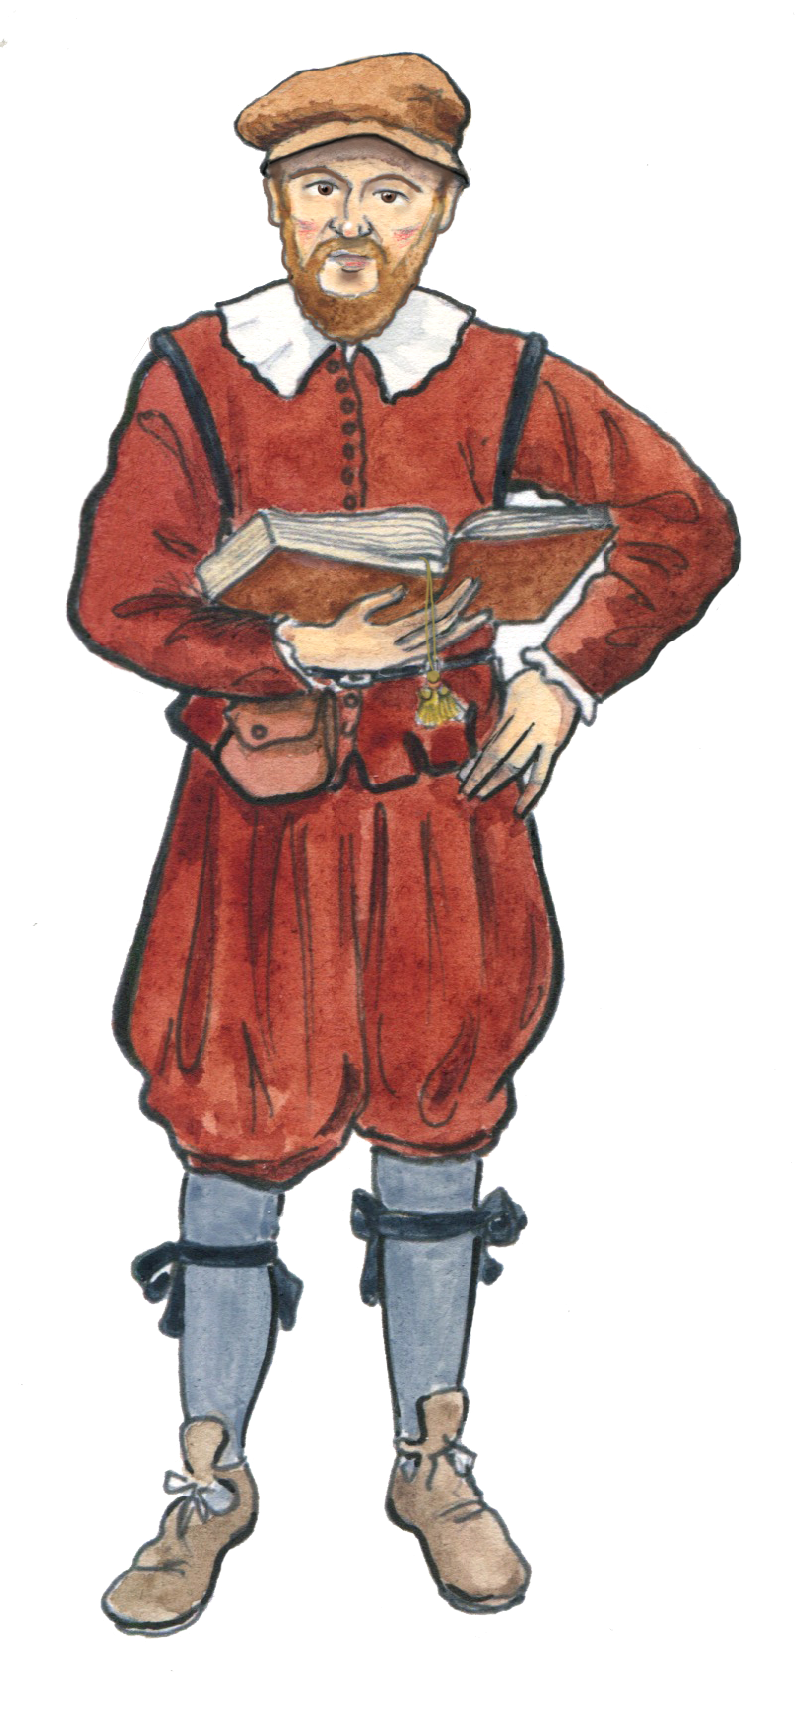
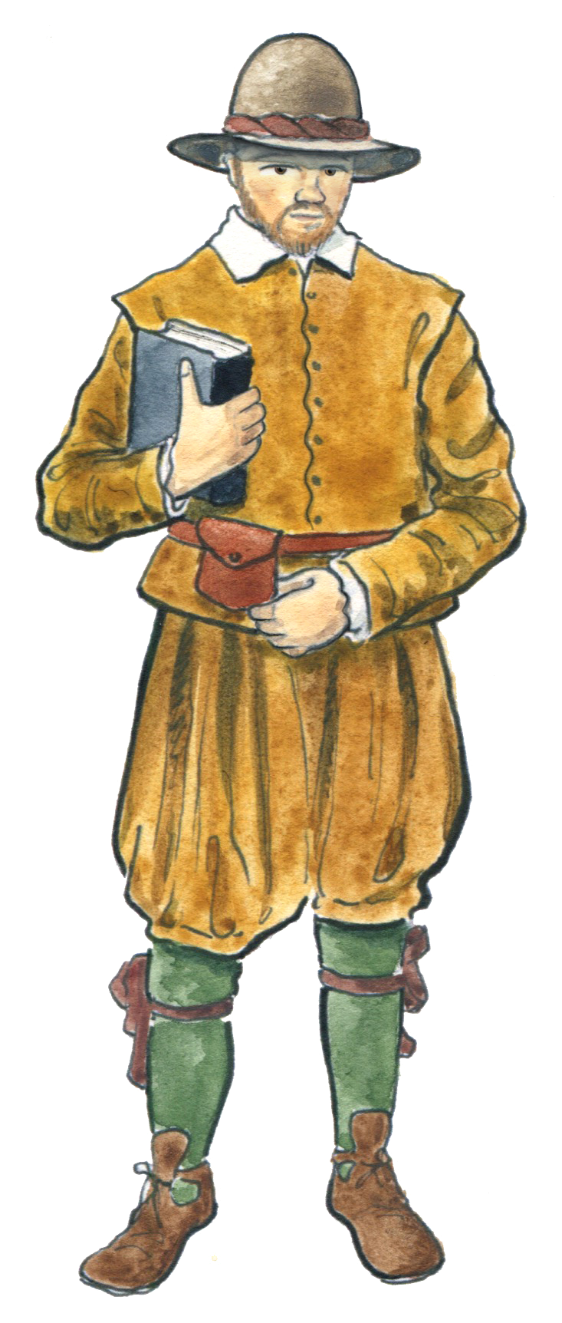
Perspectives Game
Rules:
You will be given a series of statements.
Decide in your groups and as a class, which group of people each statement belongs to: The Pilgrims or The Wampanoag
Hint: Sometimes a statement could fit both groups of people!

Slide 13
Perspectives Game
Pilgrims
Wampanoag
OR
“I don’t want to leave home!”

Slide 14
Perspectives Game
Pilgrims
Wampanoag
OR
“We know nothing about these people! I’m scared! What if they try to kill us?!”

Slide 15
Perspectives Game
Pilgrims
Wampanoag
OR
“I am frightened of such a long journey!”

Slide 16
Perspectives Game
Pilgrims
Wampanoag
OR
“We have nothing to eat, what will we do?”

Slide 17
Perspectives Game
Pilgrims
Wampanoag
OR
“Will they spread disease and make our families ill?”

Slide 18
Perspectives Game
Pilgrims
Wampanoag
OR
“How can we communicate with people if they don’t know our language?”

Slide 19
Perspectives Game
Pilgrims
Wampanoag
OR
“Will they respect our land and our traditions?”

Slide 20
Questions about the Wampanoag and the Wetu!
When you come to Bassetlaw Museum to learn more about the Wampanoag Tribe, you will get to explore the Wetu they built and ask questions.
We’d like you each to bring one question you’d like to ask us with you when you visit.
Before you write your questions, please remember the language you use is very important. Your teacher will tell you more!

Slide 21
We can’t wait to see you soon!

